Slide 1
Introduction to Computers
By Fauzan A.

Slide 2
What is a Computer?
Computer: an electronic machine/device that processes and calculates data faster than humans
  Various shapes and sizes
Computers use programs
  a set of instructions given to the device that performs a task upon execution
Hardware & Software

Slide 3
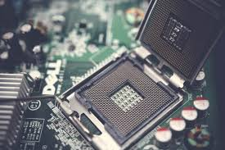
Hardware
Hardware
  the actual physical machinery that builds up a computer, but it’s practically useless without programs
5 key components
  CPU
  ALU
  Input Unit(s)
  Output Unit(s)
  Memory

Slide 4
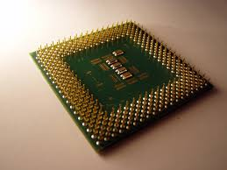
Central Processing Unit
Central Processing Unit (CPU)
  Brain of the computer
  Responsible for executing the jobs instructed through programs
  Makes sure that the functions are done accurately

Slide 5
Arithmetic Logic Unit
Arithmetic Logic Unit
  Performs the computer’s calculations and decisions
    addition, subtraction, multiplication, and division
  Performs all operations founded upon human logic

Slide 6

Input Units
Input Units
  Hardware that sends out signals to the computers to provide direct data.
  Ex. Keyboard

Slide 7
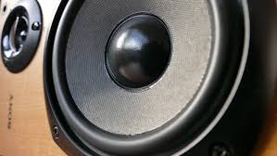
Output Units
Output Units
  Send information to another device
  Ex. Audio Speakers & Video Monitors

Slide 8
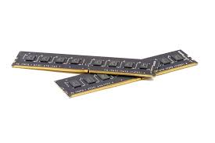
Memory
Computer’s memory is capable of storing data
Two types: Volatile and Persistent
Volatile: memory that isn’t kept
  Ex. Random Access Memory (RAM)
Persistent: memory that doesn’t delete when the computer shuts down
  nonvolatile memory
  Ex. Hard Drive or Solid State Drive (SSD)

Slide 9
Software
Software: programs utilized by the computer to execute certain functions
  made with a variety of computer languages
    Machine Language
    Assembly Language
    High-Level Language

Slide 10
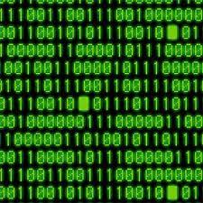
Machine Language
Machine Language
  consists of binary or hexadecimals instructions

Slide 11
Assembly Language
Assembly Language
  Low level programming language
  For hardware manipulation

Slide 12

High Level Languages
High Level Languages
  Closer to human language
  friendly for a programmers to program
  Ex. Java

